Slide 1
Being a safer pedestrian
By the Junior Road Safety Officers

Slide 2
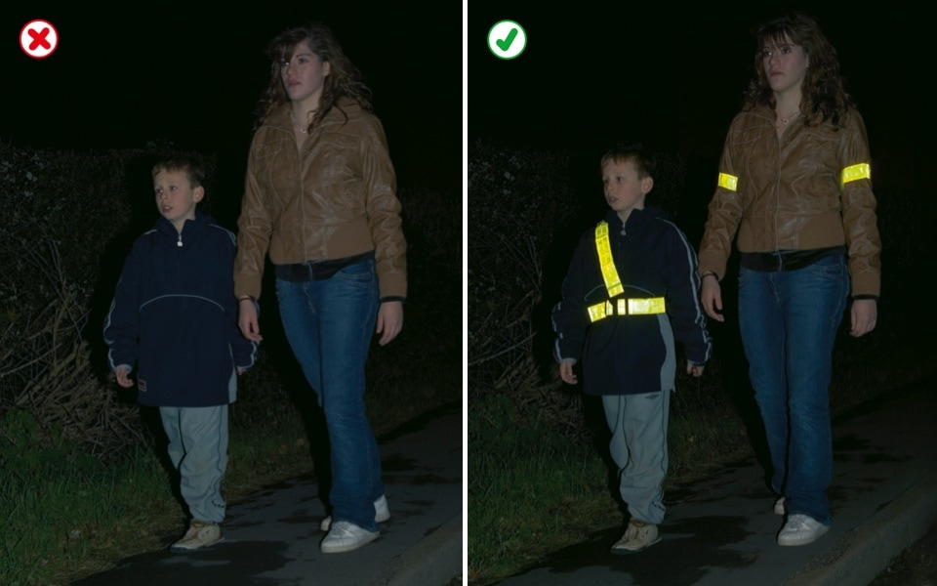
How to be safer when walking
If there is a pavement – use it (and stay away from the kerb)
If you need to pass another pedestrian, pass them safely in single file
If there is no pavement, walk close to the side of the road, on the right, facing oncoming traffic
If there is no pavement and the road bends, go one behind the other
Wear or carry something bright or reflective in dark, rainy or foggy conditions.

Slide 3
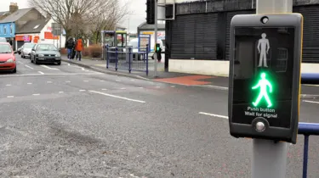
The safest places to cross…
A puffin crossing
You should still wait for the traffic to stop, even if the green man is showing
If the green man is flashing, do not start to cross

Slide 4
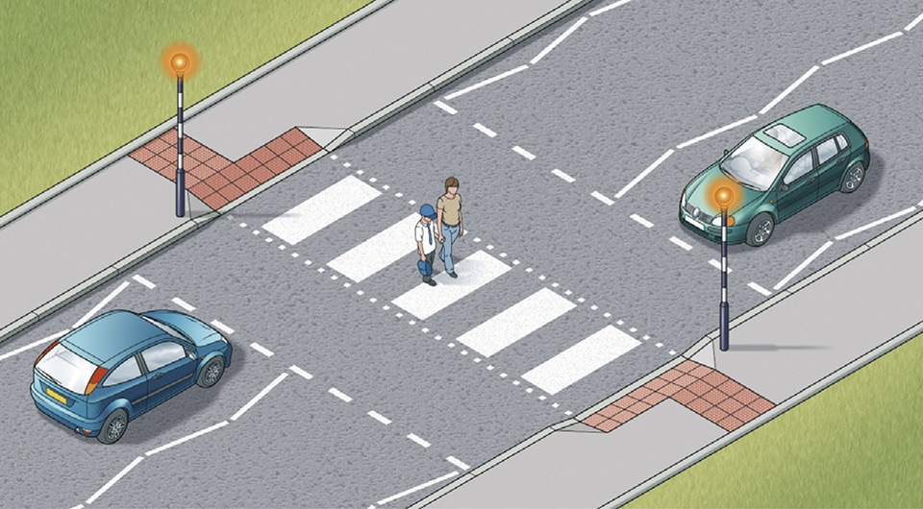
The safest places to cross
A zebra crossing
You must wait for the traffic to stop and only cross on the stripy part

Slide 5
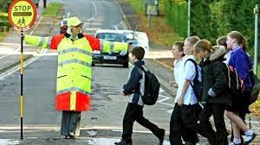
The safest places to cross…
School crossing patrol
Don’t forget to thank the lollipop person!

Slide 6

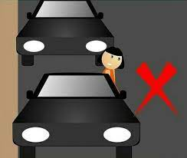
If these crossing places are not available…
NEVER cross between parked cars – drivers may not see you come out from between you
IF YOU MUST CROSS AT A JUNCTION, beware of traffic coming around the corners
ALWAYS USE THE GREEN CROSS CODE and pay attention!

Slide 7
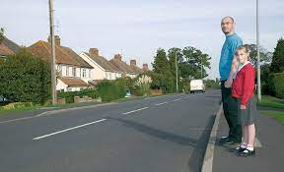
The Green Cross Code
THINK – find a safe place to cross. Use your brain before your feet!

Slide 8
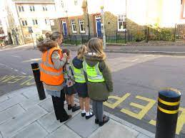
STOP – keep back from the kerb and look both ways

Slide 9
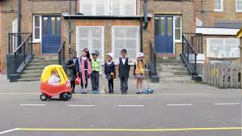
WAIT – If there is traffic coming, let it pass

Slide 10
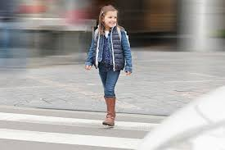
WALK, never run, straight across the road, looking and listening all the time. Remember that electric cars don’t make much noise. Pay attention to the road, not your phone or your friends

Slide 11
Competition time!
Over the Easter holidays, we would like you to produce an A4 poster on being a safer pedestrian. You could focus on walking, the Green Cross Code or where the safest places to cross are – it’s up to you.
Entry is free and the closing date is Friday 29th April
We will pick one winner per year group – the winners will be displayed on our noticeboard
There will be prizes!
Hand your entry to your teacher, who will pass them to the JRSOs or Mrs Abbott
Good Luck!

