Slide 1

Phonics and reading
phonics information session for parents in Nursery and reception

Slide 2
What we will cover today
Phonics at Broke Hall.
The systematic, synthetic teaching of phonics from phase 2 to phase 5.
The order in which the sounds are taught in class.
Resources used in school.
How the sounds are pronounced.
How you can support your children with reading and using phonics at home.
Questions.

Slide 3




Slide 4

TEACHING PHONICS
Phonics is part of the National Curriculum.
At Broke Hall we follow the Bug Club Scheme, a Government accredited scheme which outlines how phonics should be taught.

Slide 5
A whole school approach
We focus on fostering a love of reading starting in nursery.
Reading and phonics are monitored through school.
Phonics is assessed throughout Reception to Year 2. There is a statutory phonics assessment at the end of Year 1.

Slide 6
Terminology used in class
Phoneme: The smallest units of sound that are found within a word
Grapheme: The spelling of the sound e.g. ie
Diagraph: Two letters that make one sound when read e.g ai
Trigraph: Three letters that make one sound igh
CVC: Stands for consonant, vowel, consonant. Eg shop
Segmenting: breaking up a word into its sounds.
Blending: Putting the sounds together to read a word
Tricky words: Words that cannot easily be decoded.
Sound buttons/ Sound bar: dot or bar placed under the word to identify the grapheme.

Slide 7
How to say the sounds correctly
Don’t forget refer back to the letter names.
How to say the 42 sounds:
https://www.youtube.com/watch?v=-ksblMiliA8

Slide 8
Phase 1
Tuning into sounds
Listening and remembering sounds
Talking about sounds
Music and movement
Rhythm and rhyme
Sound effects
Speaking and listening skills

Slide 9
Phase 2
Set 1: s a t p
Set 2: i n m d
Set 3: g o c k
Set 4: ck e u r
Set 5: h b l f ff ll ss

Slide 10
Phase 2 – tricky words
There are many words that cannot be blended or segmented because they are irregular.
the was said you some

Slide 11
Phase 3
:
j, v, w, x, y, z, zz, qu
ch, sh, th, ng, ai, ee, igh, oa, oo,
ar, or, ur, ow, oi, ear, air, ure, er

Slide 12
Phase 3 tricky words
he she we me be way
you they all are my her

Slide 13
Phase 4
Children move into phase 4 when they know all the phonemes from phases 2 and 3 and can use them to read and spell simple words (blending to read and segmenting to spell).
Phase 4 doesn’t introduce any new phonemes.
It focuses on reading and spelling longer words with the phonemes they already know.

Slide 14
Phase 4 tricky words
have said like so do some
come were there little
out when out what

Slide 15
Phase 5
Teach new graphemes for reading
ay, ou, ie, ea, oy, ir, ue, aw, wh, ph, ew, oe, au,
a-e, e-e, i-e, o-e, u-e

Slide 16
Phase 5 tricky words
Oh there people Mr Mrs
looked called asked could

Slide 17
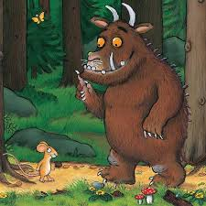
Helping at home
Focus on conversation
Encourage imaginative play at home
Listening
Discussing the pictures
Practising sounds together

Slide 18

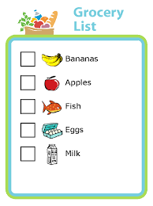
Helping at home
Shopping list
Writing words and sounds with pens and chalk
Visiting local library
Retelling events e.g going to a party
Songs and nursery rhymes

Slide 19
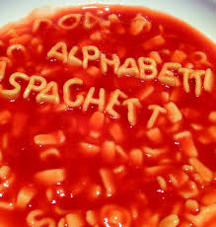




Helping at home
An opportunity to explore school resources.
Items around the home.
Print in the environment.

Slide 20
Building blocks
Regular reading at home is extremely beneficial for your child and is key to developing fluency.
The importance of the reading record.

Slide 21
Websites to support your children
Cbeebies Alphablocks
Mr Thorne does phonics-youtube.
http://www.phonicsplay.co.uk/freeIndex.htm
http://www.topmarks.co.uk/english-games/5-7-years/letters-and-sounds
http://www.bbc.co.uk/bitesize/ks1/literacy/phonics/play/
http://www.ictgames.com/literacy.html
https://www.activelearnprimary.co.uk

