Slide 1
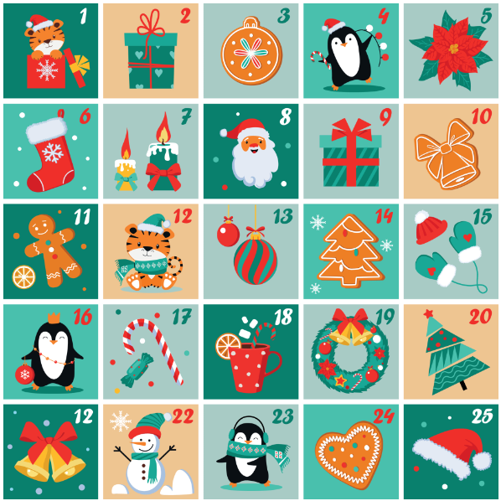

Broke Hall’s Advent Calendar
Visit each day to hear or watch a story or listen to a poem to celebrate this festive time of year.
Notes:
The second 12 is 21 – Problem from the original advent calendar. No number 25.

Slide 2
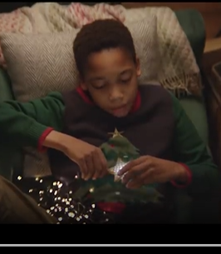
Christmas Adverts
An 'Unexpected Guest' tells an unlikely tale of a friendship between a young Earthling Nathan and a traveller from outer space, Skye.
The film starts with Nathan travelling home from school and witnessing something crashing to Earth. He ventures into the woods towards the crash site and spots the extra-terrestrial. He is unsure whether this is going to be a friendly encounter, but when the two of them realise that they are both wearing outfits with an illuminated star, then their friendship begins.
Their friend blossoms and Nathan introduces Skye to festive traditions. The short film allows the viewer to see Christmas through they eyes of someone who has never experienced it before.
Imagine you meet an alien. How would you explain Christmas to them?
Click image to play clip.

Slide 3
NATIVITY
This Christmas will be different:
the angels got the sack.
A choir of heavenly llamas sing,
conducted by a yak.
Here come the three wise penguins,
riding camels. (Well, why not?
We can’t go changing everything
to fill the festive slot!)
The shepherds on the hillside
are looking after cats.
The sky is filled with magic
from supersonic bats.
But hidden in a stable
three people never change:
Joseph, Mary, Jesus,
whose absence would be strange.
Some things in life may alter,
but some things stay the same.
May God be praised for Christmas
and Jesu’s holy name.
© Celia Warren 2024

Slide 4
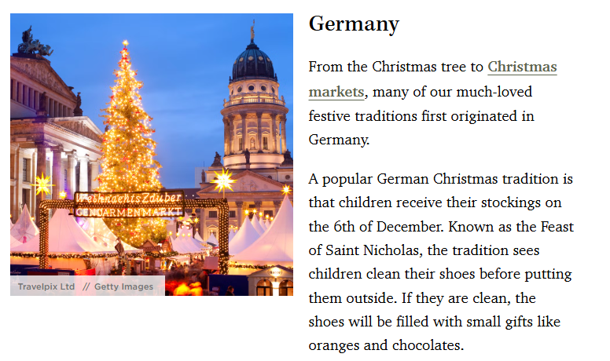

Slide 5

Snowball
~ Shel Silverstein
I made myself a snowball,
As perfect as could be,
I thought I'd keep it as a pet,
And let it sleep with me.
I made it some pajamas,
And a pillow for its head,
Then last night it ran away,
But first - it wet the bed!

Slide 6
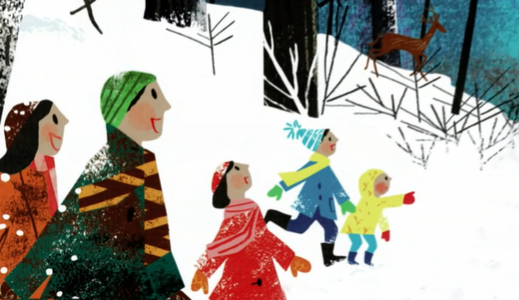
Walking in a Winter Wonderland
Click image to play clip.

Slide 7
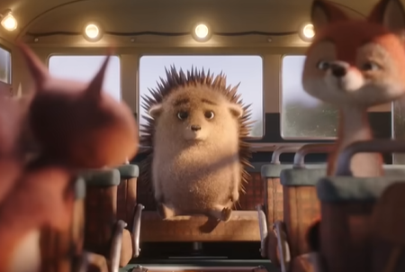
Click image to play clip.
Christmas Adverts
The advert is called, ‘What Would Christmas be like without Love?’ Do you think this is a good title?
How did the hedgehog feel?
How did the other animals feel?

Slide 8
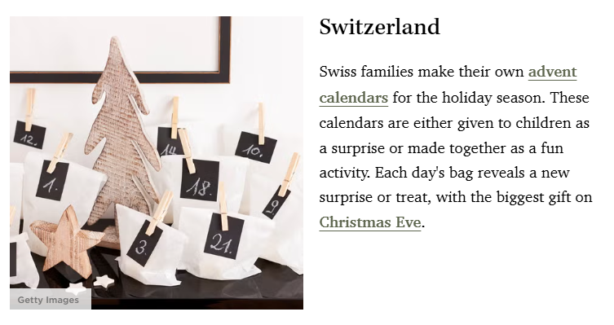
Christmas Traditions

Slide 9
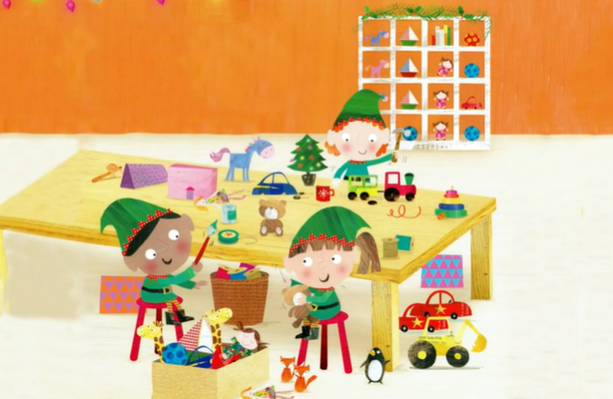
The Christmas Selfie Contest
Click image to play clip.

Slide 10
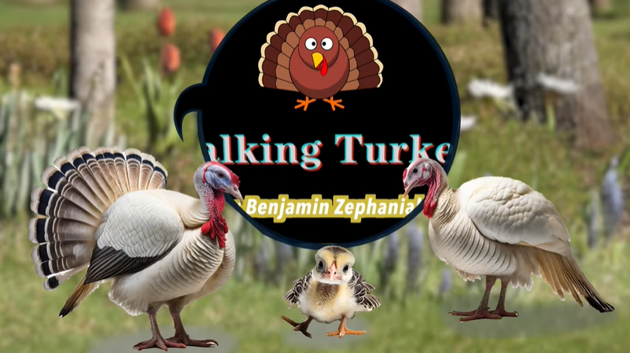
Benjamin Zephaniah – Talking Turkey Poem
Click image to play clip.

Slide 11
Christmas Traditions
Christmas Spiders
Believe it or not, there such as thing as a Christmas spider. In the Ukraine, the Christmas trees are decorated with spider webs – don’t freak out, they are ornaments that look like spider webs, which are said to bring good luck. The tale goes all the way back to a poor woman who couldn’t afford ornaments to decorate her tree with. The next morning, she woke up and her tree was covered with spider webs that look all sparkly and beautiful in the sunlight. Other countries, like Poland or Germany, consider it good luck if they find a spider or spider web in the Christmas tree.

Slide 12
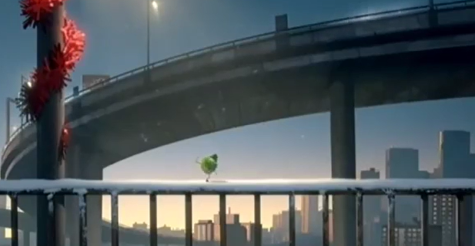
Christmas Adverts
What surprised you about this advert?
How did it make you feel?
How did you feel for the sprout?
Click image to play clip.

Slide 13
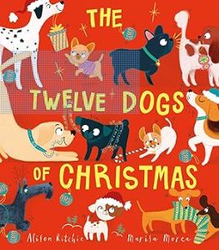
The Twelve Dogs of Christmas
Click image to play clip.

Slide 14
Christmas Traditions
Pudding Throwing in Slovakia
In Slovakia there is the odd Christmas tradition of throwing pudding on the ceiling.
As a way of finding out how much luck a family will have in the coming year, the most senior member has to throw loksa pudding at the ceiling. The more that sticks the more luck the family will have.
The traditional recipe includes milk, bread, poppy seeds and something to add a little sweetness... or stickiness as the case may be.

Slide 15
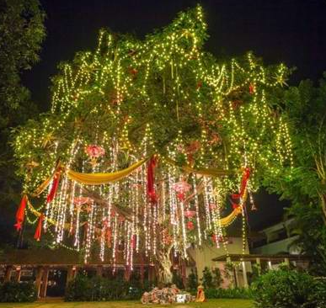
Christmas Traditions
Banana and mango Christmas trees
Around 2% of India’s total population identify as Christians. Although this isn’t a large percentage, when you consider India’s massive population of around 1.2 billion, the Christmas-celebrating Christian population suddenly becomes more significant. The coastal state of Goa has a large Christian population, who decorate banana and mango trees in festive finery when Christmas comes around, given that fir and pine trees are few and far between in India!

Slide 16
I’ve been asked for a ghost that will only haunt cheese,
For a two-hundred-metre-long snake,
For a tree made of soup,
For a sabre-toothed shark,
For four unicorn nose hairs that glow in the dark,
For a sausage that flies,
For a bottom that talks,
For an active volcano that does funny walks,
For alien snot,
For a shed on the moon,
And a thumb-sized baboon that can play the bassoon,
These impossible things are too hard to deliver,
And that’s why I’m writing to plead,
This Christmas don’t wish for the things that you want,
Just wish for the things that you need.
Jonathan Sellars
A Letter FROM Father Christmas
Each year many millions of letters
Arrive in great sacks at my door,
And it takes me a week to climb up to the top
Of the mountain they make on the floor,
I read every one, I note every wish,
It takes quite a while but I do,
Then me and my elves do the best that we can
To make all those wishes come true,
But…
You wouldn’t believe the requests I receive,
The wishes that some children make,

Slide 17
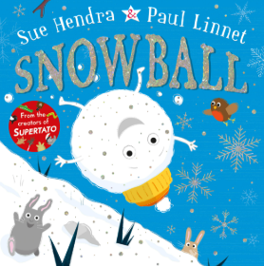
Winter Story
Click image to play clip.

Slide 18
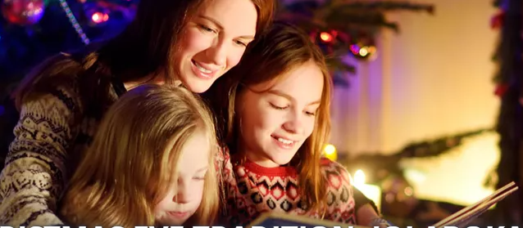
Christmas Traditions
Jolabokaflod, translating to "Christmas Book Flood," is a unique and cherished tradition in Iceland, celebrated on Christmas Eve. This tradition involves giving and receiving new books, but its essence lies in the joy of reading them together.

Slide 19
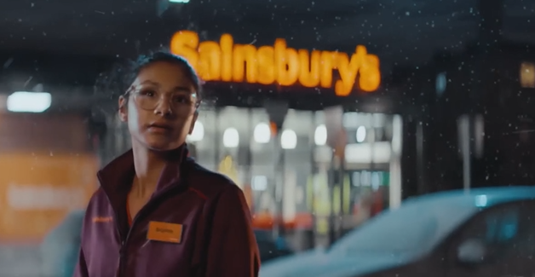
Christmas Adverts
Sainsbury’s Big Christmas
What do you notice about the main characters in this advert?
Do you think it is a good idea to use book characters to sell things at this time of year?
Click image to play clip.

Slide 20
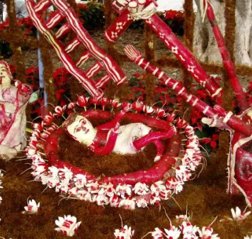
Christmas Traditions
Night of the Radishes
We’ve all seen a nativity scene or two, but in Oaxaca, Mexico, they do nativity with a difference. Each year, on December 23, residents come together to make nativity scenes from radishes. This tradition, which is called Noche de los Rábanos (Night of the Radishes), dates back to the 18th century when the Spanish introduced radishes to Mexico from their native China.
One year, a few radishes were missed during the harvest. When they were eventually discovered, they had grown large and misshapen. The radishes were sold at a local Christmas market on December 23, and carved into novelty shapes and figures for a nativity scene. In 1897, the mayor of Oaxaca created a competition to make the best radish nativity scene, which is still going strong today!

Slide 21
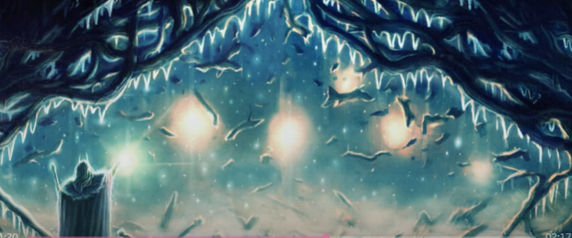
Bedtime Christmas Story
When It Snows
Click image to play clip.

Slide 22
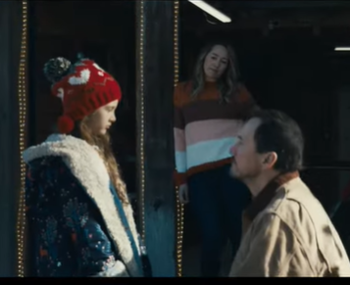
Christmas Adverts
Coca Cola 2020
One Dad, planning on working away for Christmas, takes his daughter's letter for Santa with him to post. Unfortunately, he misses the 'post boat' and a series of mishaps means that he ultimately ends up delivering the letter to The North Pole himself.
He receives a lift home and is surprised by the contents of the letter when he gets there.
What ideas for some gifts 'only you can give' this Christmas do you have?
Click image to play clip.

Slide 23
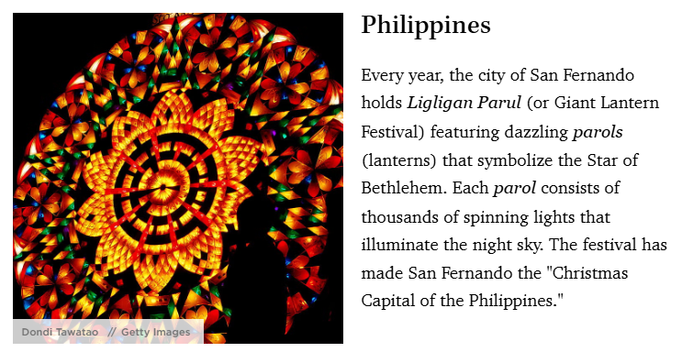
Christmas Traditions

Slide 24
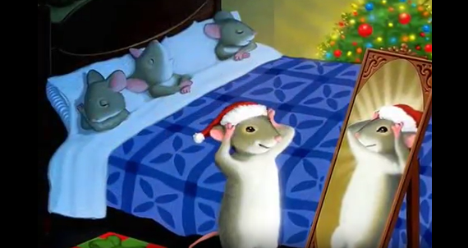
Twas the Night Before Christmas
Click image to play clip.

Slide 25
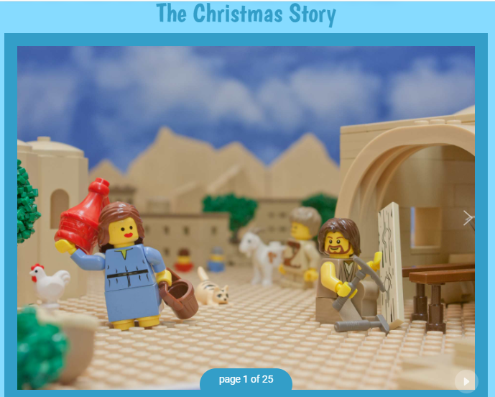
Click image to play clip.

Slide 26


